Slide 1
REGISTER ADDRESSING:
Register addressing is the most common form of data addressing.
The MP contains the following 8-bit registers used with register addressing: AH, AL, BH, BL, CH, CL, DH, & DL.
•16-bit registers: AX, BX, CX, DX, SP, BP, SI, & DI.
It is important for instructions to use registers that are the same size.

Slide 2
Cont.
Never Mix an 8-bit register with a 16-bit register because this is not allowed by MP & results in an error when assembled.
MOV AX, AL instruction is not allowed because these registers are of different sizes.
Exception: SHL DX, CL
None of the MOV instructions affect the flag bits.

Slide 3
Cont.
See Table (3-1), P-78, BREY.
- A segment-to-segment register MOV instruction is about only type of register MOV instruction not allowed.
Code segment (CS) register is not normally changed by a MOV instruction, because the address of the next instruction is fund in both IP & CS. If only CS were changed, the address of the next instruction would be unpredictable. Therefore, changing CS register with a MOV instruction is not allowed.

Slide 4
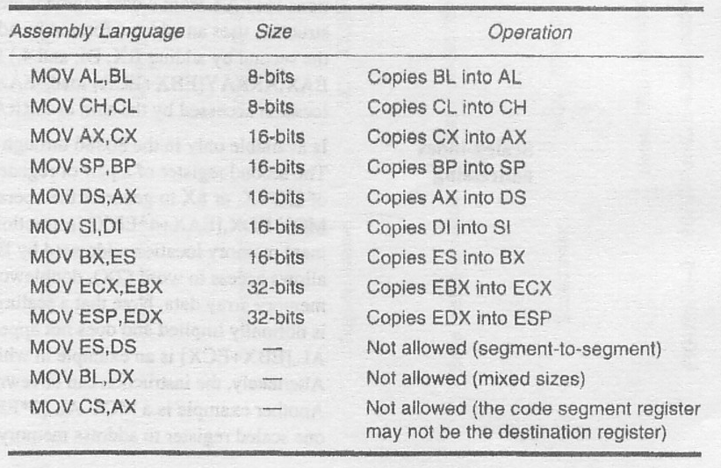
Table 3.1: register add. instructions

Slide 5
Cont.
See fig (3.3), P-79, BREY.
MOV BX, CX
source register contents do not changed, but the destination register’s contents do changed.
The instruction moves (copies) a 1234H from register CX into register BX.
This erases the old contents (76AFH) of register BX, but the contents of CX remain unchanged.

Slide 6
Cont.
The contents of destination register/destination memory location change for all instructions except the CMP & TEST ins.
Register array
AX BX CX
76 | AF
 |  | 1234
12 | 34
MOV BX, CX

Slide 7
IMMEDIATE ADDRESSING:
Terms Immediate implies that the data immediately follow the hexadecimal opcode in memory.
Immediate data are constant data, while data transferred from a register are variable data.
Immediate addressing operates upon a byte/word of data.
MOV immediate instruction transfer a copy of the immediate data into a register/a memory location.

Slide 8
Cont.
MOV AX, 3456H instruction copies 3456H from the instruction, located in the memory immediately following hexadecimal opcode into register AX.
Register array MOV AX, 3456H AX
BX
3456H
62 | 91

Slide 9
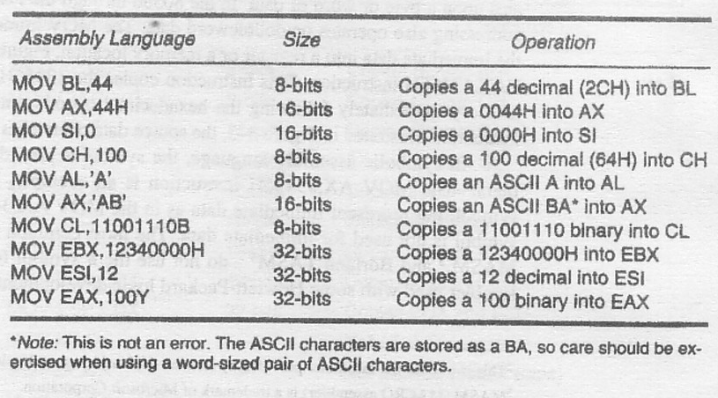
Table 3.2:immediate addressing

Slide 10
DIRECT DATA ADDRESSING:
Most instructions can use direct data- addressing mode.
•Two basic forms of direct data addressing:
1.Direct addressing, which applies to a MOV bet’n a memory location & AL, AX 2.Displacement addressing: applies to almost
any instruction in the instruction set.

Slide 11
Cont.
In either case, address is formed by adding displacement to the default data segment or alternate segment address.
Direct Addressing:
Direct addressing with a MOV instruction transfers data bet’n a memory location, located within data segment & AL (8-bit), AX (16-bit) register.

Slide 12
Cont.
Register array Memory
AX BX CX
11235H
11234H
11233H
11232H
AH | AL 8AH
8AH
8A
MOV AL, [1234H], DS = 1000H

Slide 13
Cont.
The effective address is formed by adding 1234H (offset address) to 1000H (data segment address of 1000H) in a system operating in real mode.
MOV instruction using this type of addressing is a 3-byte long instruction.
See table (3-3), P-82, BREY

Slide 14
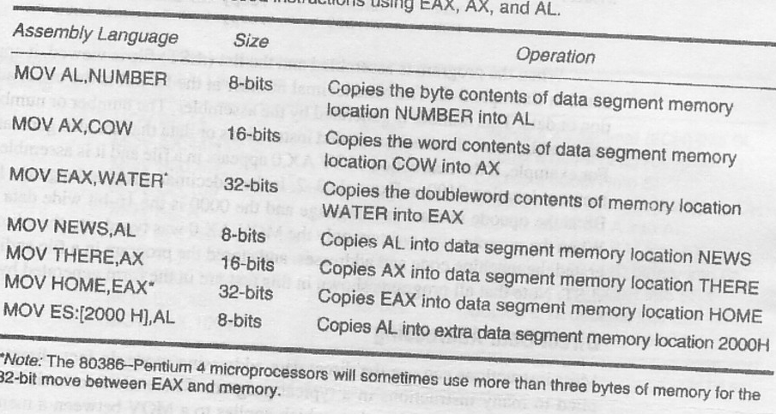
Table 3.3: Direct addressing

Slide 15
REGISTER INDIRECT ADDRESSING:
•Register indirect addressing allows data to be addressed at any memory location through an offset address hold in any of following registers: BP, BX, DI & SI.
•Exam: BX contains 1000H & MOV AX ,[BX] executes.
•word contents of data segment offset address 1000H are copied into register AX.

Slide 16
Cont.
•If MP operated in real mode & DS = 0100H, this instruction addresses a word stored at memory bytes 2000H & 2001H & transfer it into register AX.
Contents 2000H moved into AL &
Contents 2001H …………….AH
[] symbol denotes indirect addressing in assembly language.
see fig.(3-6), P-84, BREY

Slide 17
Cont.
AX BX CX
3412
34
12
02002
02001
02000
AH 34 | AL 12
10 | 00
+
1000 2000
CX DS
01002
01001
01000
0100
01000
MOV AX, [BX], BX = 1000H, DS = 0100H

Slide 18
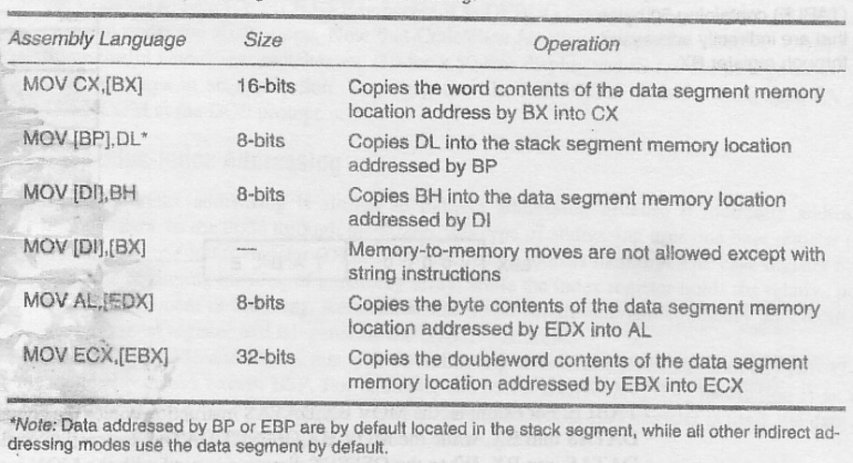
Table 3.5: register indirect addressing

Slide 19
Base-plus-Index Addressing:
Base-plus-index addressing is similar to indirect addressing because it indirectly addresses memory data.
In 8086, this type of addressing uses one base register (BP/BX) & one index register (DI/SI) to indirectly address memory.
Base register often holds the begging location of a memory array, while index register holds relative position of an element in the array.

Slide 20
Cont.
Remember, whenever BP addresses memory data, both stack segment register & BP generate effective address.
•Locating Data with Base-plus-index Addressing:
•See Fig (3-8), P-87, BREY & Table (3-6), P-88, BREY.

Slide 21
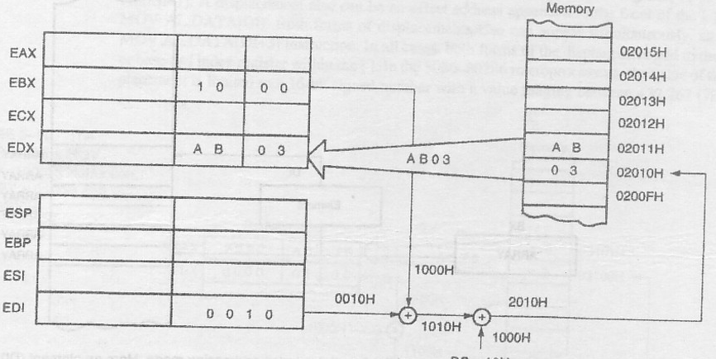
Fig 3.8:MOV DX, [BX + DI]
DS * 10
DS = 0100H, BX = 1000H, DI = 0010H

Slide 22
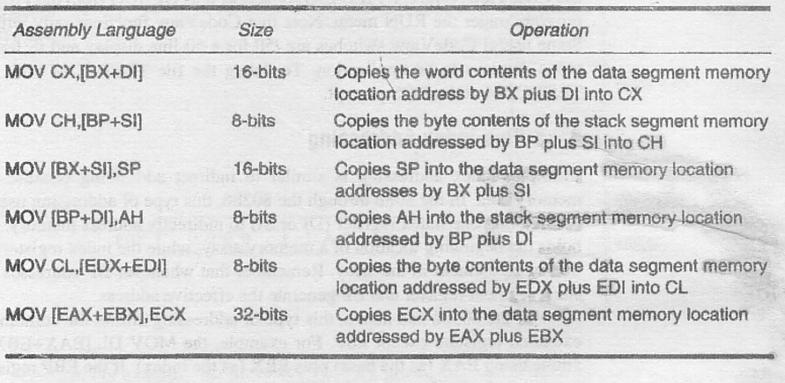

Slide 23
Cont.
MOV DX, [BX + DI] or MOV DX,[BX][DI] DS = 0100H
BX = 1000H DI = 0010H
for prog. written for Intel
ASM assembler

Slide 24
Locating array data using Base-plus-Index Addressing:
•A major use of base-plus-index addressing mode is to address elements in a memory array.
•Suppose, the elements in an array, located in data segment at memory location ARRAY,must be accessed.
•To accomplish this load BX with the beginning address of array & DI with element no. to be accessed. See fig(3-9),p-88

Slide 25
Fig 3.9: base plus index addressing. Element (DI) of an ARRAY (BX) is addressed
ARRAY + 5
ARRAY + 4
ARRAY + 3
ARRAY + 2
ARRAY + 1 ARRAY
DI
Element
BX
ARRAY

Slide 26
Register Relative Addressing:
Register relative addressing is similar to base-plus-index addressing & displacement addressing.
In register relative addressing, data in a segment of memory are addressed by adding displacement to the contents of a base/index register (BP, BX, DI & SI).
see fig. (3-10), P-89, BREY.

Slide 27
Cont.
Register Array
memory
A0
76
AX BX
A0 | 76
01 | 00
A076
3101H
3100H
0100H
1000H
+
1100H
DS * 10H
+
2000H 3100H
MOV AX, [BX + 1000H], BX = 0100H, DS = 0200H

Slide 28
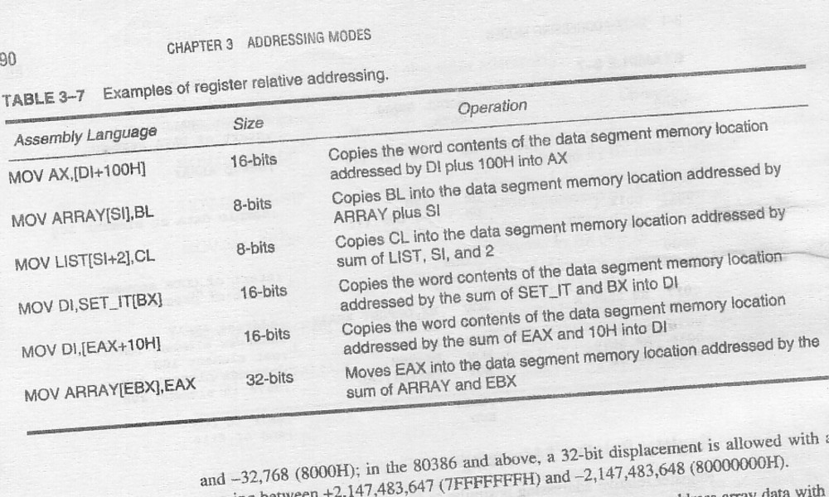
Table 3.7: register relative addressing

Slide 29
Cont.
Displacement also can be an offset address appended to the front of [] such as:
MOV AL, DATA [DI]
Both forms of displacement also can appear simultaneously,
MOV AL DATA[DI + 3]
In all cases, both forms of displacement add to the base or base & index register within [].

Slide 30
Base Relative-plus-Index Addressing:
The base relative-plus-index addressing mode is similar to the base-plus-index addressing mode, but it adds a displacement besides using a base register & an index register, to form the memory address.
This type of addressing mode often addresses a two dimensional array of memory data.

Slide 31
Addressing Data with base relative-plus-index:
Base relative-plus-index addressing is least used addressing mode.
This addressing mode is too complex for frequent use in a program.
See fig(3-12),P-91, BREY
•Also see table(3-8),P-92, BREY.
MOV AX, [BX+SI+100], DS= 1000H, BX=0020H, SI=0010H, DS=1000H.

Slide 32
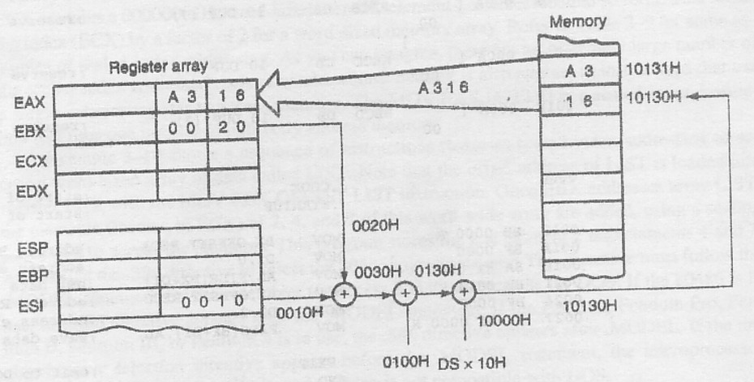
Fig 3.12: base relative plus index addressing
MOV AX, [BX + SI + 100H]
DS = 1000H

Slide 33
STACK MEMORY ADDRESSING MODES:
The stack plays an important role in all MP.
It holds data temporarily & store return addresses for procedures.
Stack memory is a LIFO (Last-in-First-out) memory, which describes the way that data are stored & removed from the stack.
data placed onto stack with a PUSH instruction & removed with a POP instruction.

Slide 34
Cont.
CALL instruction also uses the stack to hold the return address for procedures
•RET (return) instruction to remove the return address from the stack.
The stack memory is maintained by the two register:
Stack Pointer (SP)
Stack Segment (SS)

Slide 35
Cont.
Whenever a word of data is pushed onto the stack, the high-order 8-bits are placed in the location addressed by SP-1.
Low-order 8bits are placed in the location addressed by SP-2.
SP is then decrement by 2 so that next word of data is stored in the next available stack memory location.

Slide 36
Cont.
SP register always points to an area of memory located within stack segment.
SP register adds to SS * 10H to form memory address in real mode.

Slide 37
Example: PUSH BX
PUSH [BX]
=2FFE + SS*10H
=2FFE + 40000H
=42FFE
given, DS = 2000H [BX] = 0200H [SP] = 3000H [SS] = 4000H
3000H - 2 = 2FFE

Slide 38
Cont.
Register Array
Memory
AX BX CX DX
12 | 34
12
34
42FFF
1234
42FFE
SP
3000
+
SS * 10H
PUSH BX

Slide 39
Cont.
Whenever data Popped from the stack, low-order 8-bits are removed from the location addressed by SP.
High-order 8-bits are removed from the location addressed by SP + 1.
SP register is then incremented by 2.
PUSH & POP always store or retrieve words of data-never bytes in 8086.

Slide 40
Cont.
Register Array
Memory
AX BX CX DX
12 | 34
12
34
1234
SP
+
SS * 10H
POP CX

Slide 41
String Data Transfer
DI & SI –
During the execution of a string instruction, memory accesses occur through either or both of the DI and SI registers.
DI offset address accesses data in the extra segment for all string instructions.
SI offset address accesses data, by default, in the data segment.
The reason that one pointer addresses data in the extra segment and the other in the data segment is so that the MOVS instruction can move 64K bytes of data from one segment of memory to another.

Slide 42
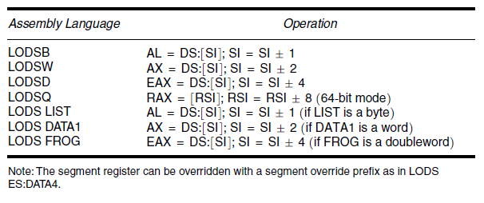
String Data Transfer
LODS –
The LODS instruction loads AL, AX, or EAX with data stored at the data segment offset address indexed by the SI register.
After loading AL with a byte, AX with a word, or EAX with a doubleword, the contents of SI increment, if D = 0 or decrement, if D = 1.

Slide 43
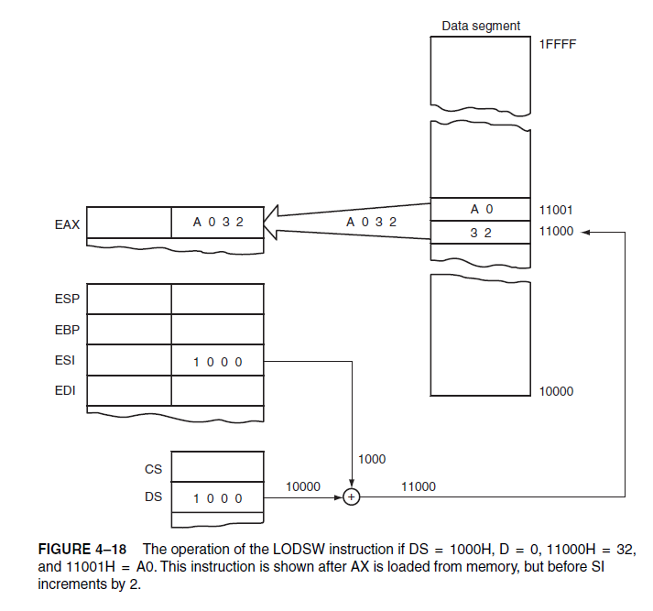
String Data Transfer
LODS –

Slide 44
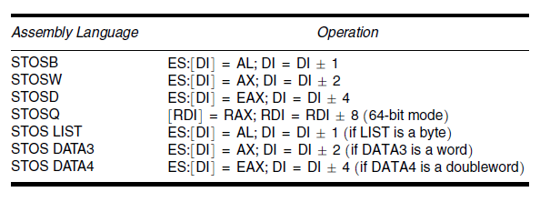
String Data Transfer
STOS –
The STOS instruction stores AL, AX, or EAX at the extra segment memory location addressed by the DI register.
After loading AL with a byte, AX with a word, or EAX with a doubleword, the contents of DI increment, if D = 0 or decrement, if D = 1.

Slide 45
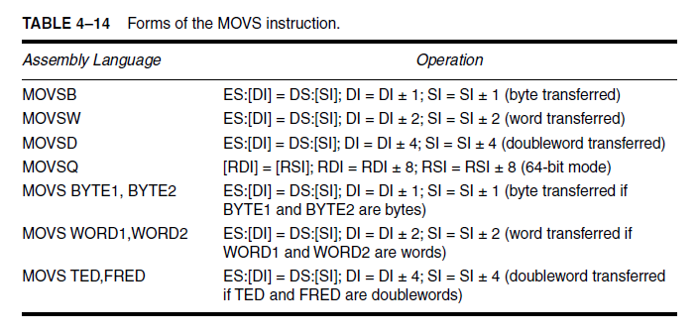
String Data Transfer
MOVS –
One of the more useful string data transfer instructions is MOVS, because it transfers data from one memory location to another. This is the only memory-to-memory transfer allowed in the 8086–Pentium 4 microprocessors.
MOVS instruction transfers a byte, word, or doubleword from the data segment location addressed by SI to the extra segment location addressed by DI.

Slide 46
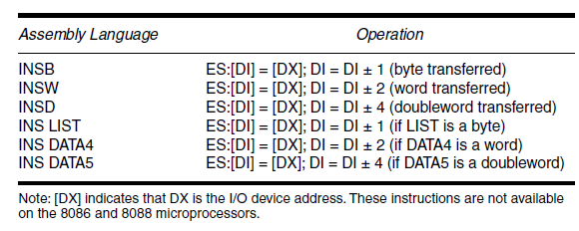
String Data Transfer
INS – (input string)
INS instruction transfers a byte, word, or doubleword of data from an I/O device into the extra segment memory location addressed by the DI register.
The I/O address is contained in the DX register. This instruction is useful for inputting a block of data from an external I/O device directly into the memory.

Slide 47
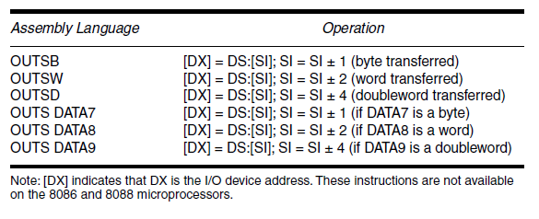
String Data Transfer
OUTS – (output string)
OUTS instruction transfers a byte, word, or doubleword of data from the data segment memory location address by SI to an I/O device.
The I/O device is addressed by the DX register.

